Slide 1
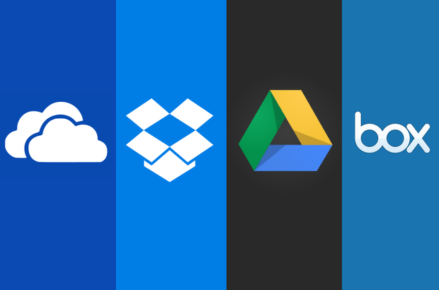

CLOUD COMPUTING
When it's smarter to rent
than to buy.....
Presented By:-
EduTechlearners

Slide 2
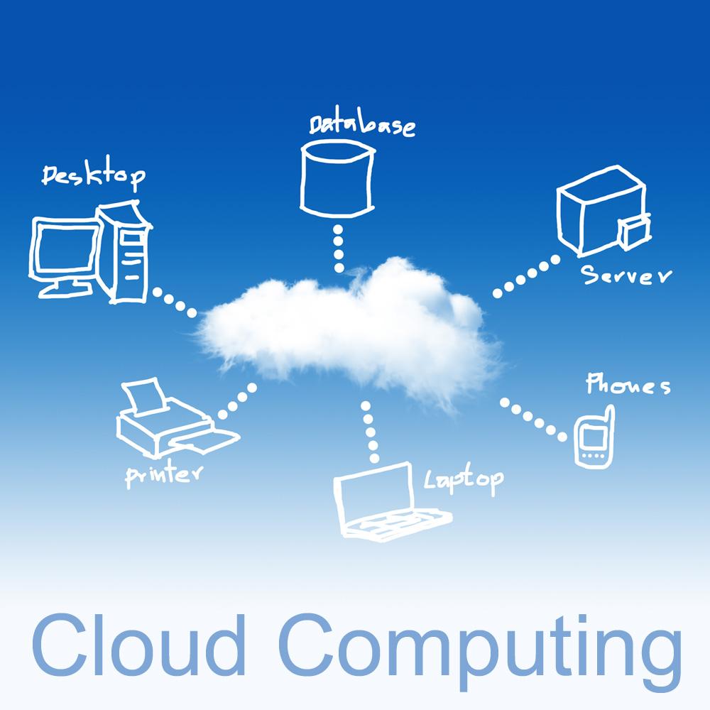
What is Cloud Computing?
In computer networking, cloud computing is computing that involves a large number of computers connected through a communication network such as the Internet, similar to utility computing. In science, cloud computing is a synonym for distributed computing over a network, and means the ability to run a program or application on many connected computers at the same time.
In simple Cloud computing is using the internet to access someone else's software running on someone else's hardware in someone else's data center.
An environment created in a user’s machine from an on-line application stored on the cloud and run through a web browser.

Slide 3
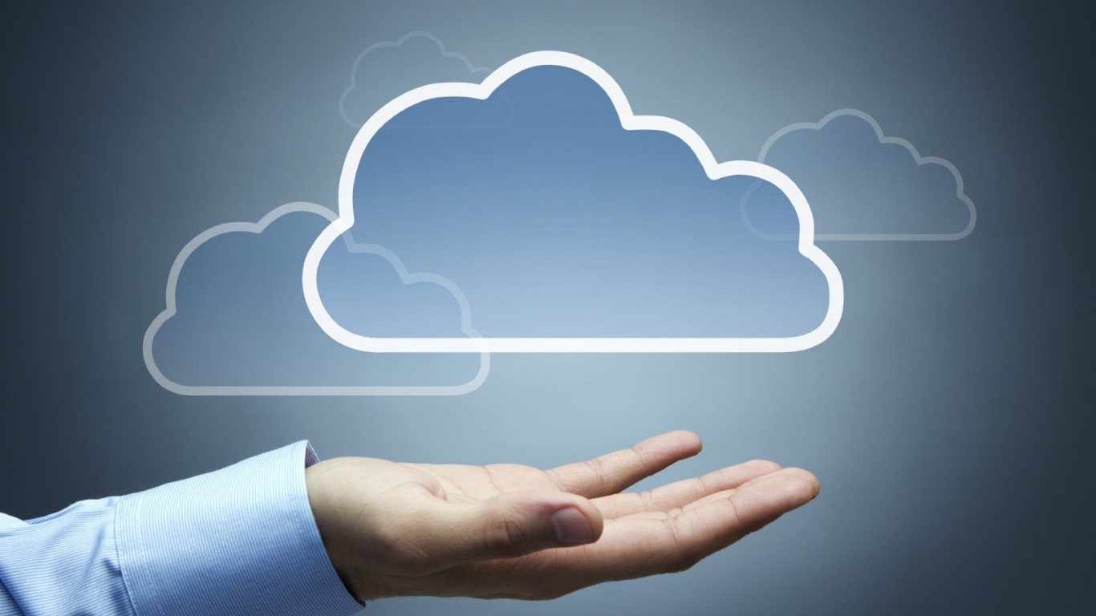
Cloud Computing (Cont.)
Features
Use of internet-based services to support business process
Rent IT-services on a utility-like basis
Attributes
Rapid deployment
Low startup costs/ capital investments
Costs based on usage or subscription
Multi-tenant sharing of services/ resources
Essential characteristics
On demand self-service
Ubiquitous network access
Location independent resource pooling
Rapid elasticity
Measured service
Notes:
3

Slide 4
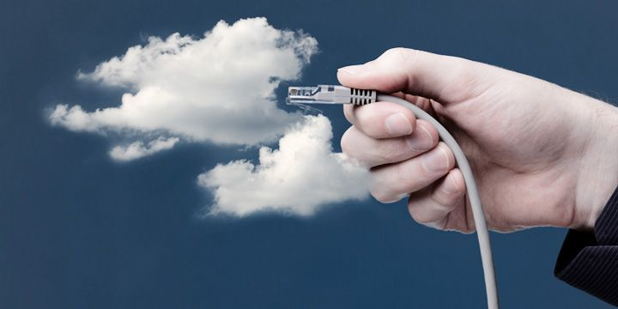
Cloud Computing: who should use it?
Cloud computing definitely makes sense if your own security is weak, missing features, or below average.
Ultimately, if
the cloud provider’s security people are “better” than yours (and leveraged at least as efficiently),
the web-services interfaces don’t introduce too many new vulnerabilities, and
the cloud provider aims at least as high as you do, at security goals, then cloud computing has better security.

Slide 5

CLOUD MODELS
CLOUD MODELS
DELIVERY MODELS
SaaS (Software as Service)
PaaS (Platform as a Service)
DEPLOYMENT MODELS
Private Cloud
IaaS (Infrastructure as a Service)
Public Cloud
Hybrid Cloud
Community Cloud

Slide 6

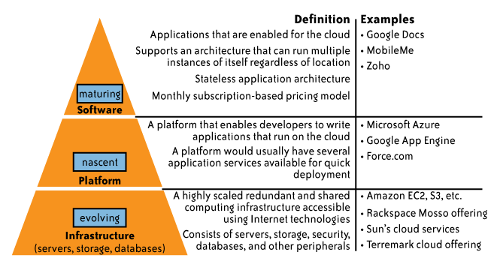
Delivery Models
While cloud-based software services are maturing,
Cloud platform and infrastructure offering are still in their early stages

Slide 7

Deployment Models
Public cloud (off-site and remote) describes cloud computing where resources are dynamically provisioned on an on-demand, self-service basis over the Internet, via web applications/web services, open API, from a third-party provider who bills on a utility computing basis.
Private cloud environment is often the first step for a corporation prior to adopting a public cloud initiative. Corporations have discovered the benefits of consolidating shared services on virtualized hardware deployed from a primary datacenter to serve local and remote users.
Hybrid cloud environment consists of some portion of computing resources on-site (on premise) and off-site (public cloud). By integrating public cloud services, users can leverage cloud solutions for specific functions that are too costly to maintain on-premise such as virtual server disaster recovery, backups and test/development environments.
Community cloud is formed when several organizations with similar requirements share common infrastructure. Costs are spread over fewer users than a public cloud but more than a single tenant.

Slide 8
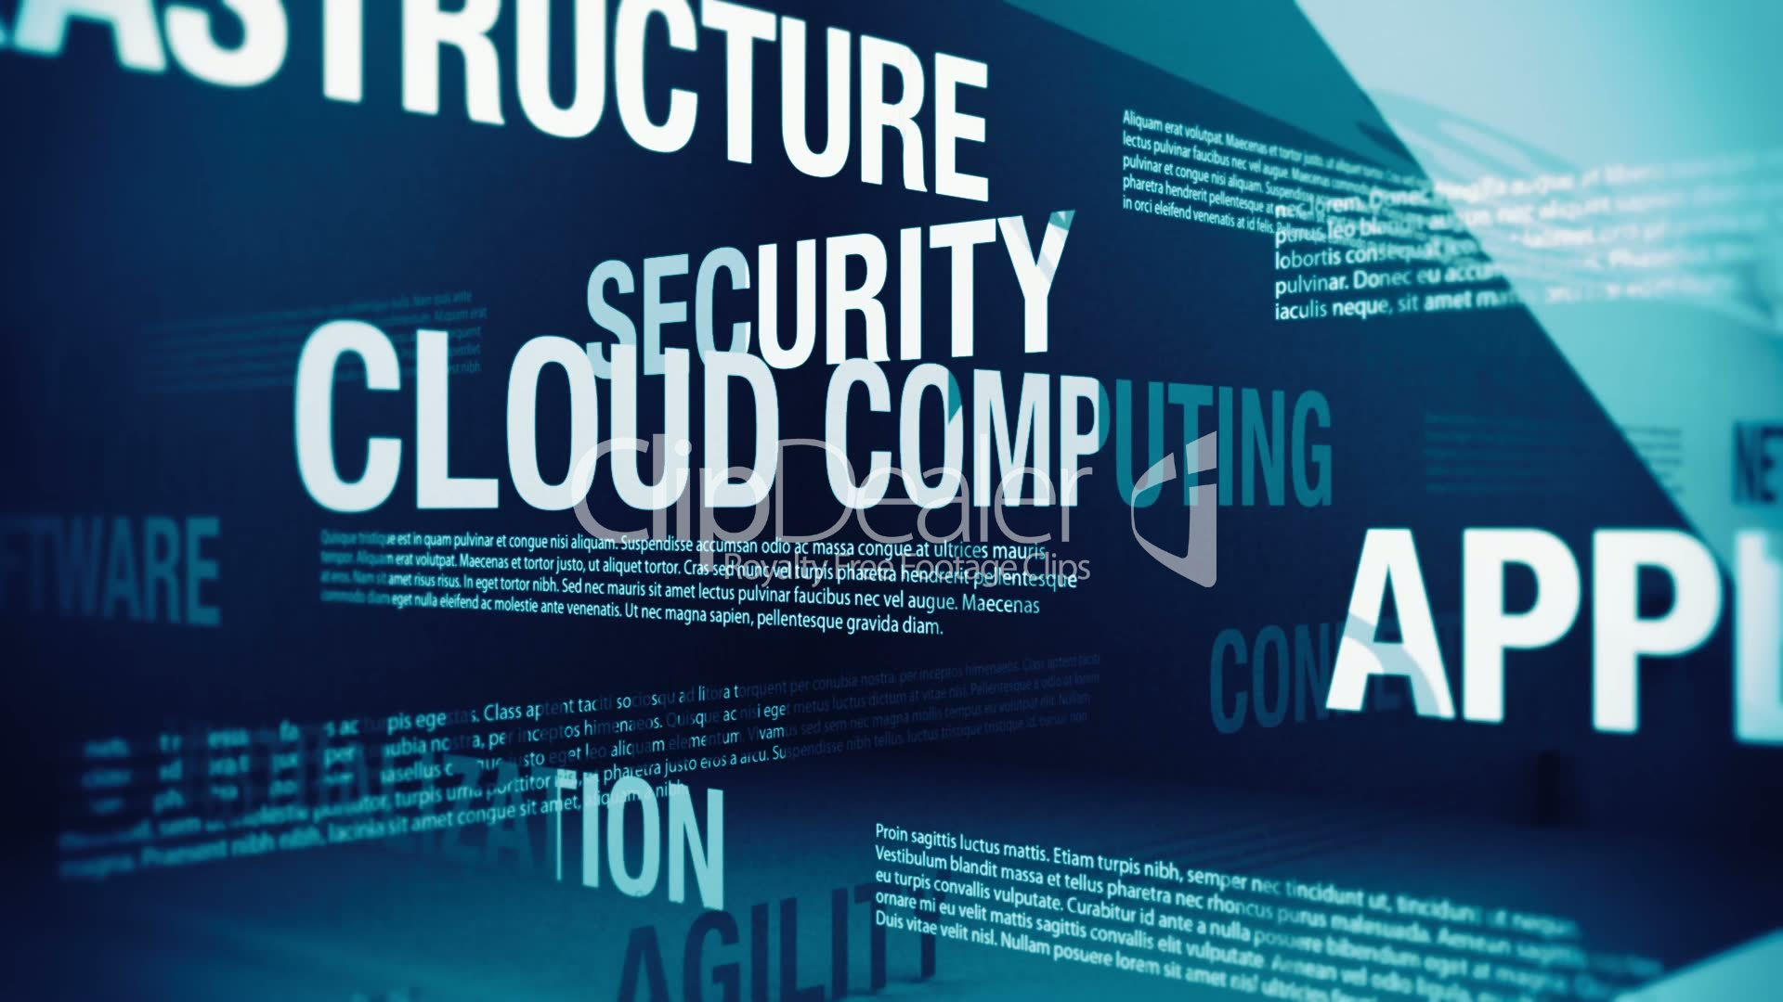
If cloud computing is so great, why isn’t everyone doing it?
The cloud acts as a big black box, nothing inside the cloud is visible to the clients.
Clients have no idea or control over what happens inside a cloud.
Even if the cloud provider is honest, it can have malicious system admins who can tamper with the VMs and violate confidentiality and integrity.
Clouds are still subject to traditional data confidentiality, integrity, availability, and privacy issues, plus some additional attacks.

Slide 9
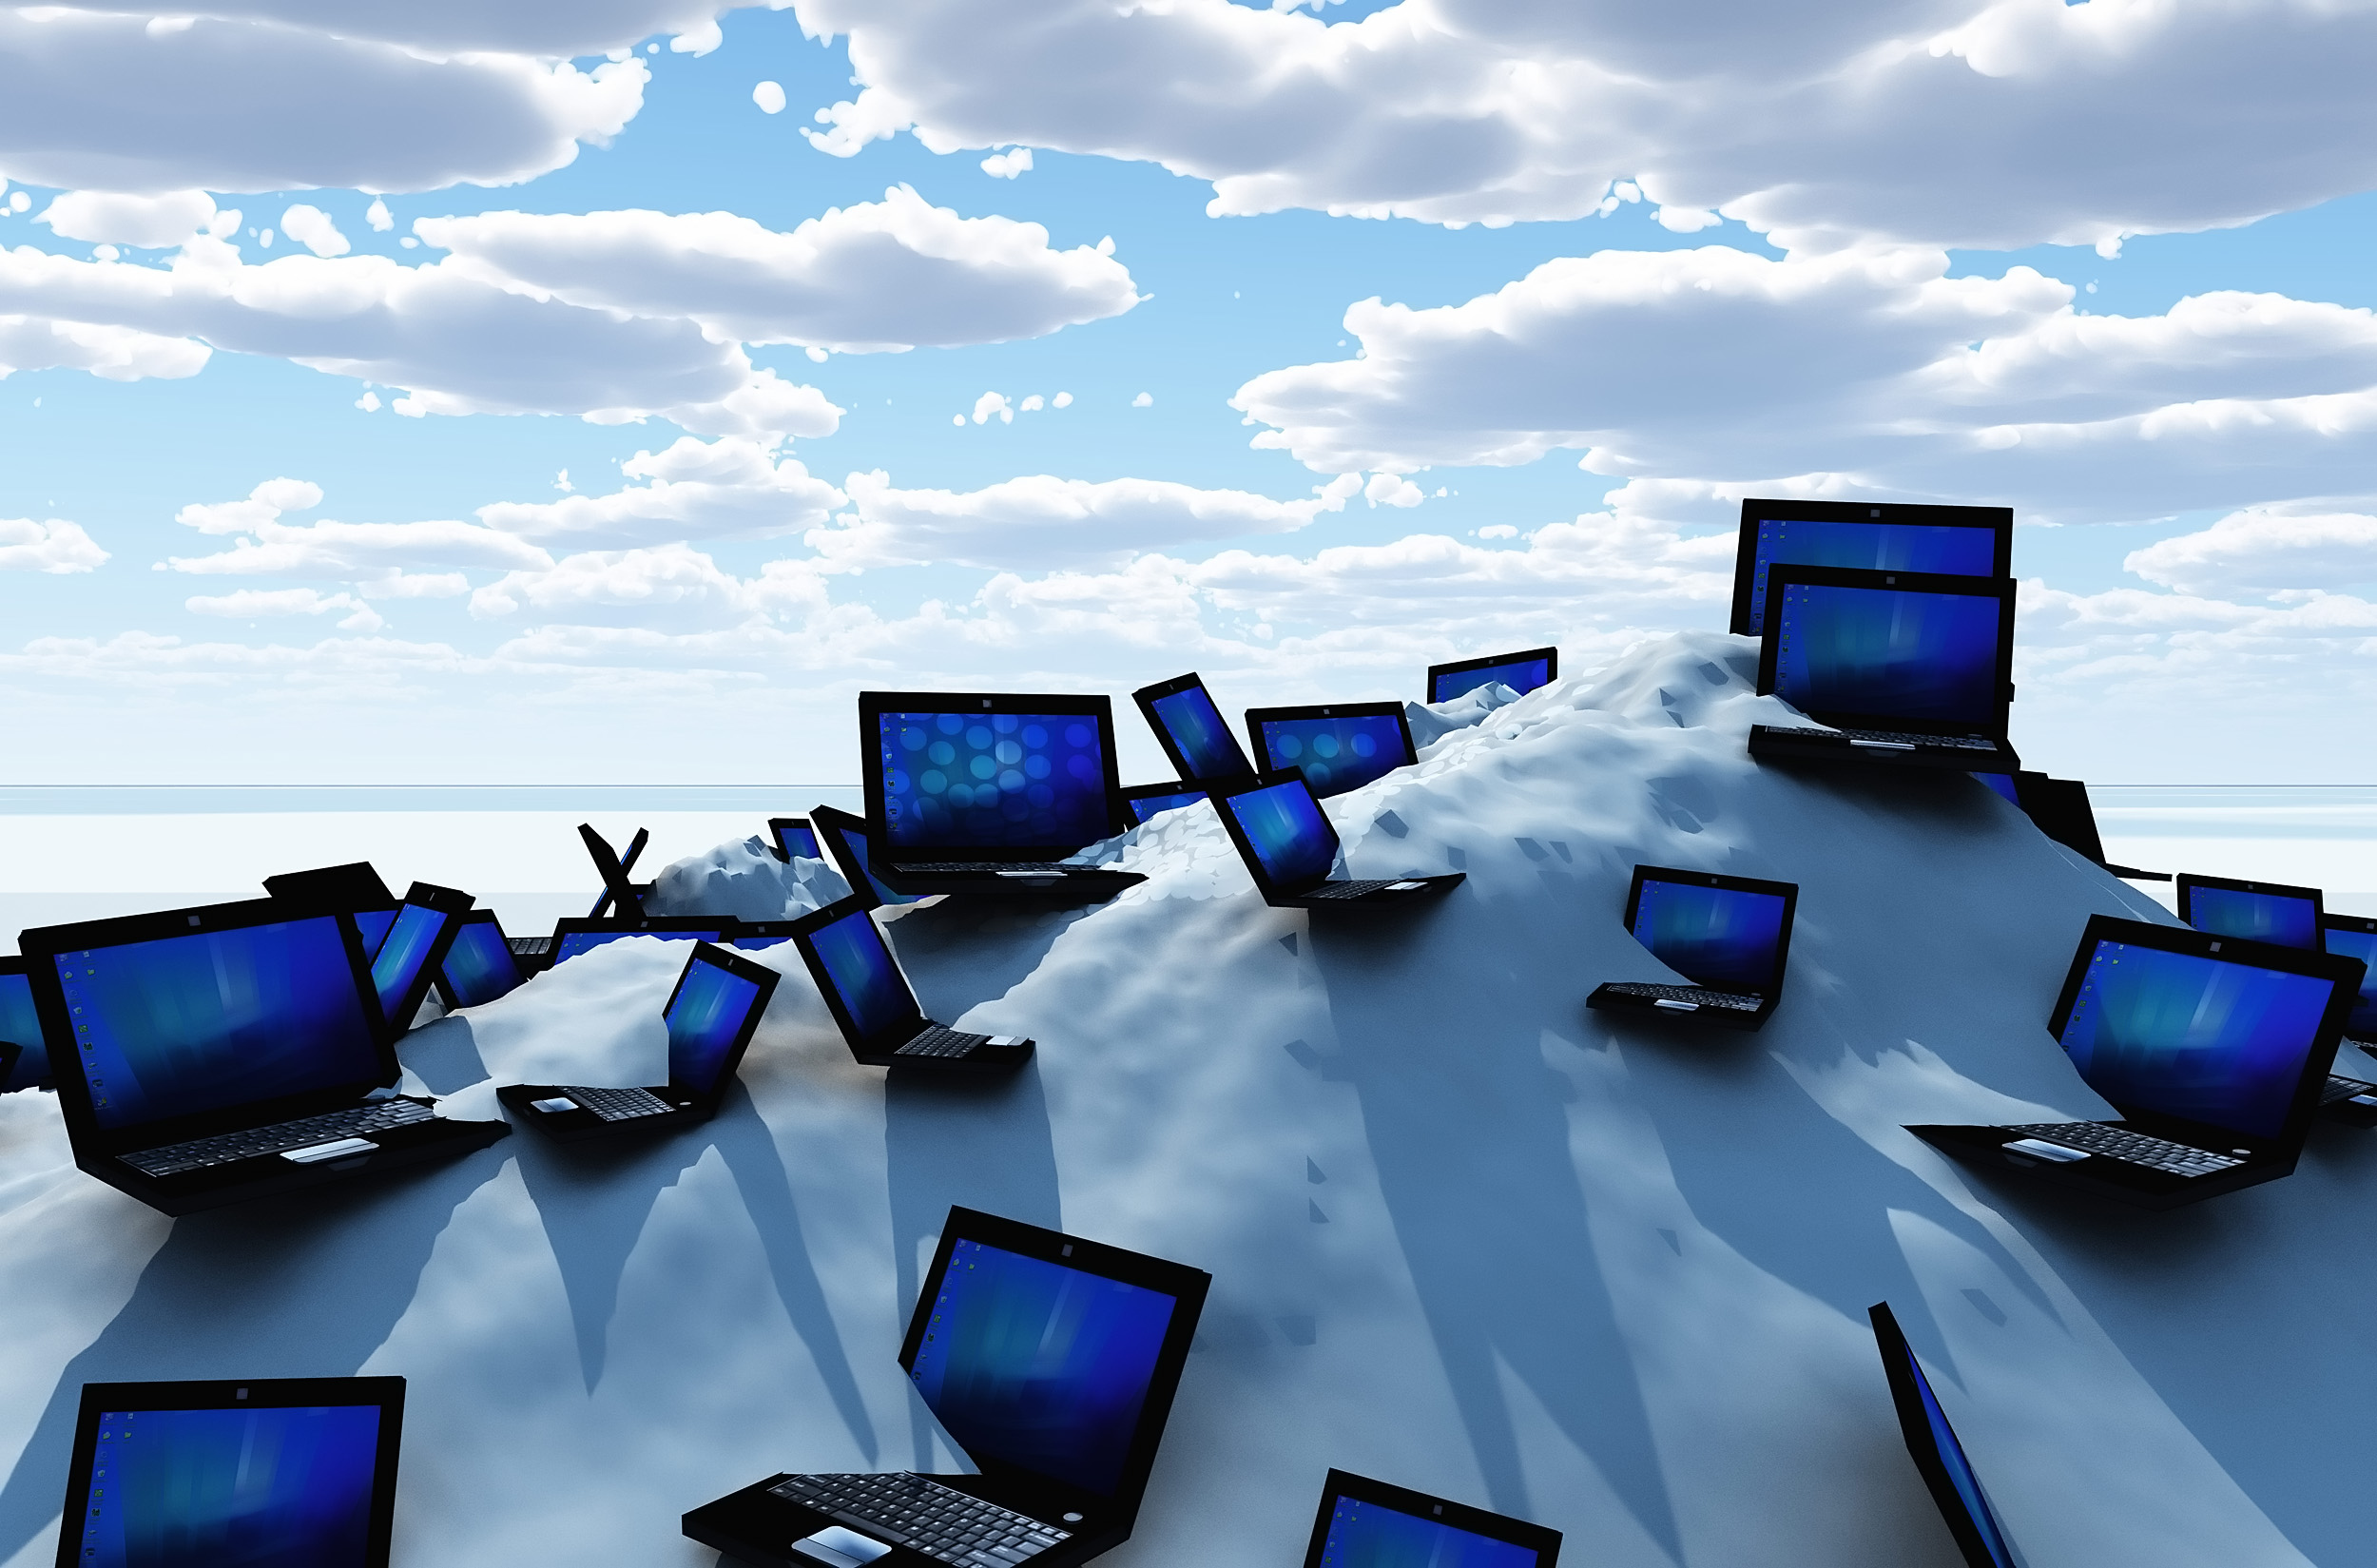
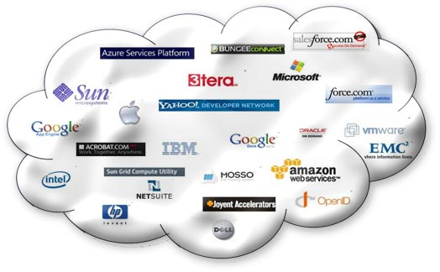
CLOUD STORAGE PROVIDING COMPANIES

Slide 10

The use of the cloud provides a number of opportunities:
It enables services to be used without any understanding of their infrastructure.
Cloud computing works using economies of scale:
It potentially lowers the outlay expense for start up companies, as they would no longer need to buy their own software or servers.
Cost would be by on-demand pricing.
Vendors and Service providers claim costs by establishing an ongoing revenue stream.
Data and services are stored remotely but accessible from “anywhere”.

Slide 11
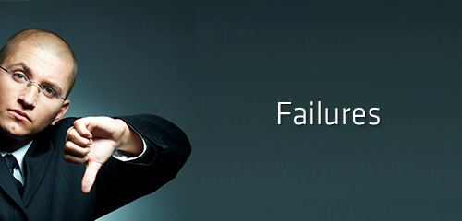
In parallel there has been backlash against cloud computing:
Use of cloud computing means dependence on others and that could possibly limit flexibility and innovation:
The others are likely become the bigger Internet companies like Google and IBM, who may monopolise the market.
Some argue that this use of supercomputers is a return to the time of mainframe computing that the PC was a reaction against.
Security could prove to be a big issue:
It is still unclear how safe out-sourced data is and when using these services ownership of data is not always clear.
There are also issues relating to policy and access:
If your data is stored abroad whose policy do you adhere to?
What happens if the remote server goes down?
How will you then access files?
There have been cases of users being locked out of accounts and losing access to data.
Notes:
Freedom of Information == FOI

Slide 12
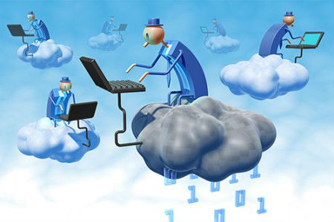
Advantages
Lower computer costs
Improved performance
Reduced software costs
Instant software updates
Improved document format compatibility
Unlimited storage capacity
Increased data reliability
Universal document access
Latest version availability
Easier group collaboration
Device independence

Slide 13

Disadvantages
Requires a constant Internet connection
Does not work well with low-speed connection
Features might be limited
Can be slow
Stored data might not be secure
Stored data can be lost

Slide 14

Conclusion
Cloud Computing is outpacing the IT industry
Real business value can be realized by customers of all sizes
Cloud solutions are simple to acquire, don’t require long term contracts and are easier to scale up and down as needed
Proper planning and migration services are needed to ensure a successful implementation
Public and Private Clouds can be deployed together to leverage the best of both
Third party monitoring services ensure customer are getting the most out of their cloud environment
Security Compliance and Monitoring is achievable with careful planning and analysis

Slide 15

Thank You!!!

